Slide 1
TATA Project (1)
File created on: 4/17/2024 6:55:06 PM

Slide 2
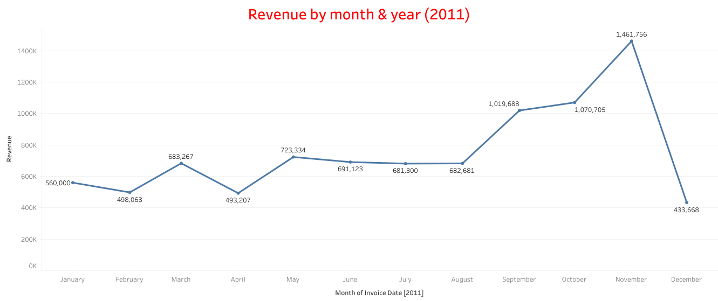

Slide 3
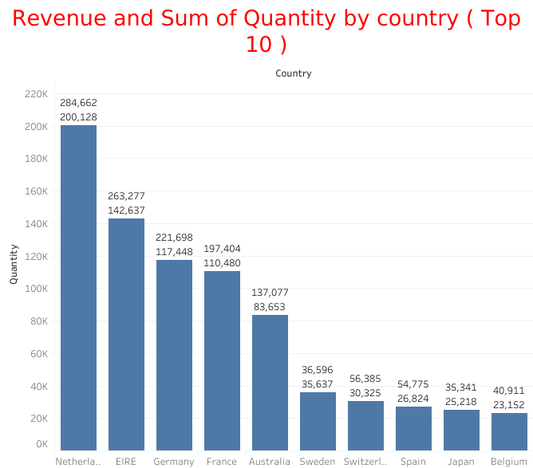

Slide 4
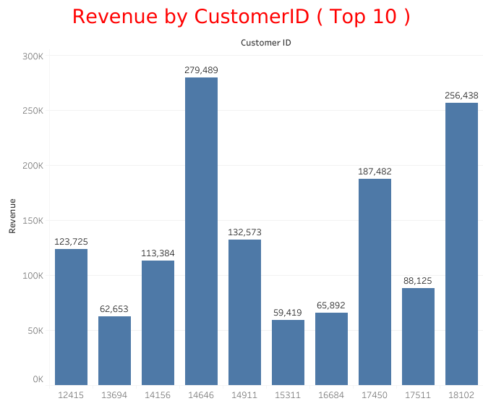

Slide 5
